Slide 1

Made by
Nebl Gergő
Kis-Borbás Dorián Zsolt
Mészáros Roland
Notes:
... Let us introduce carcomps! made by Nebl Gergő (Database) , Kis-Borbás Dorián Zsolt (Backend), Mészáros Roland (PM, Frontend).

Slide 2
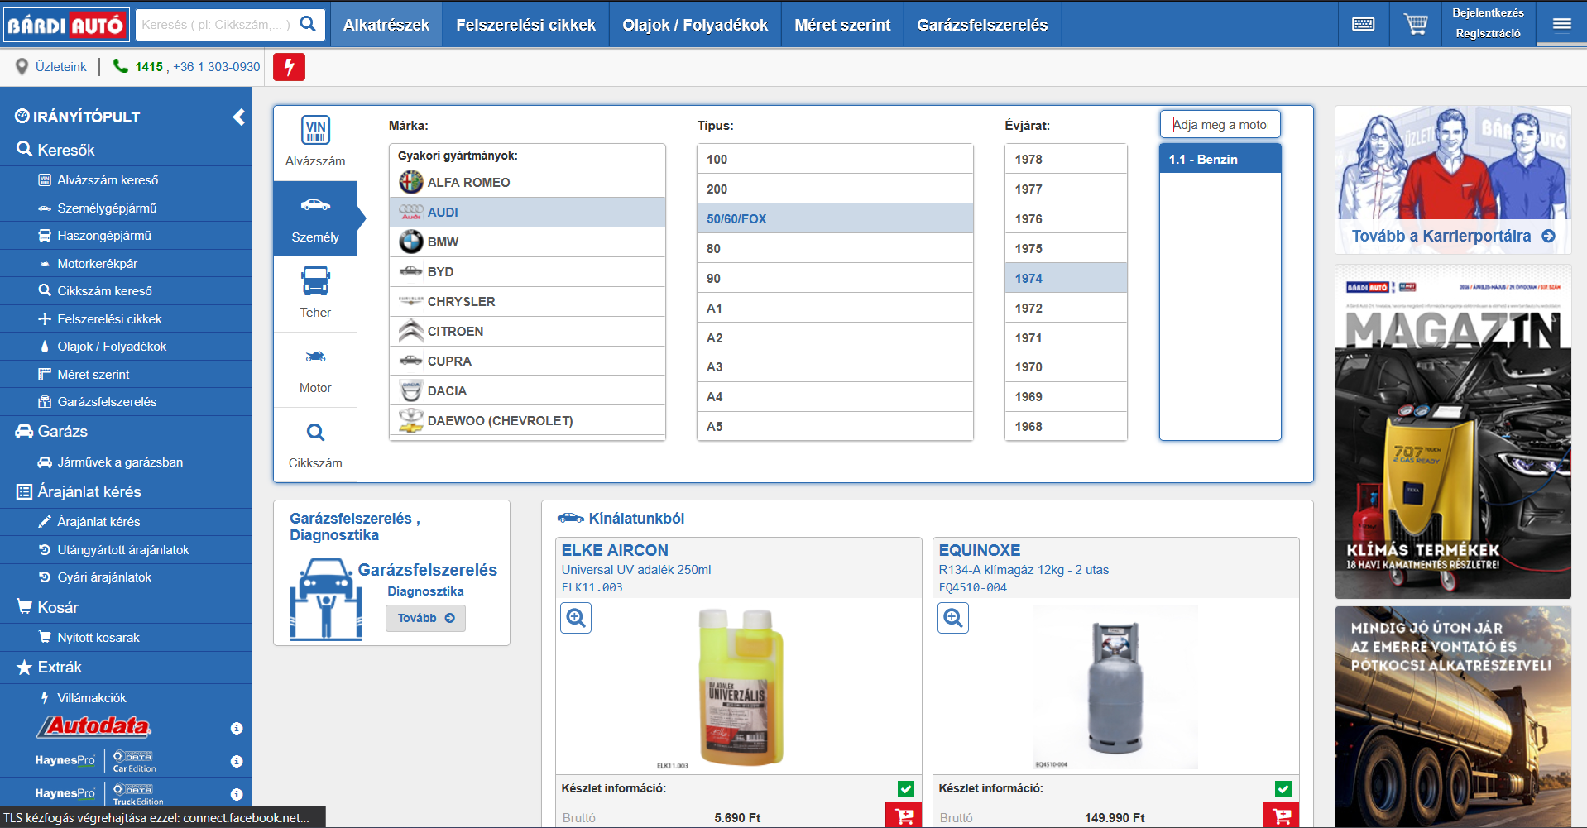
Notes:
... Let us introduce carcomps! made by Nebl Gergő (Database) , Kis-Borbás Dorián Zsolt (Backend), Mészáros Roland (PM, Frontend).

Slide 3
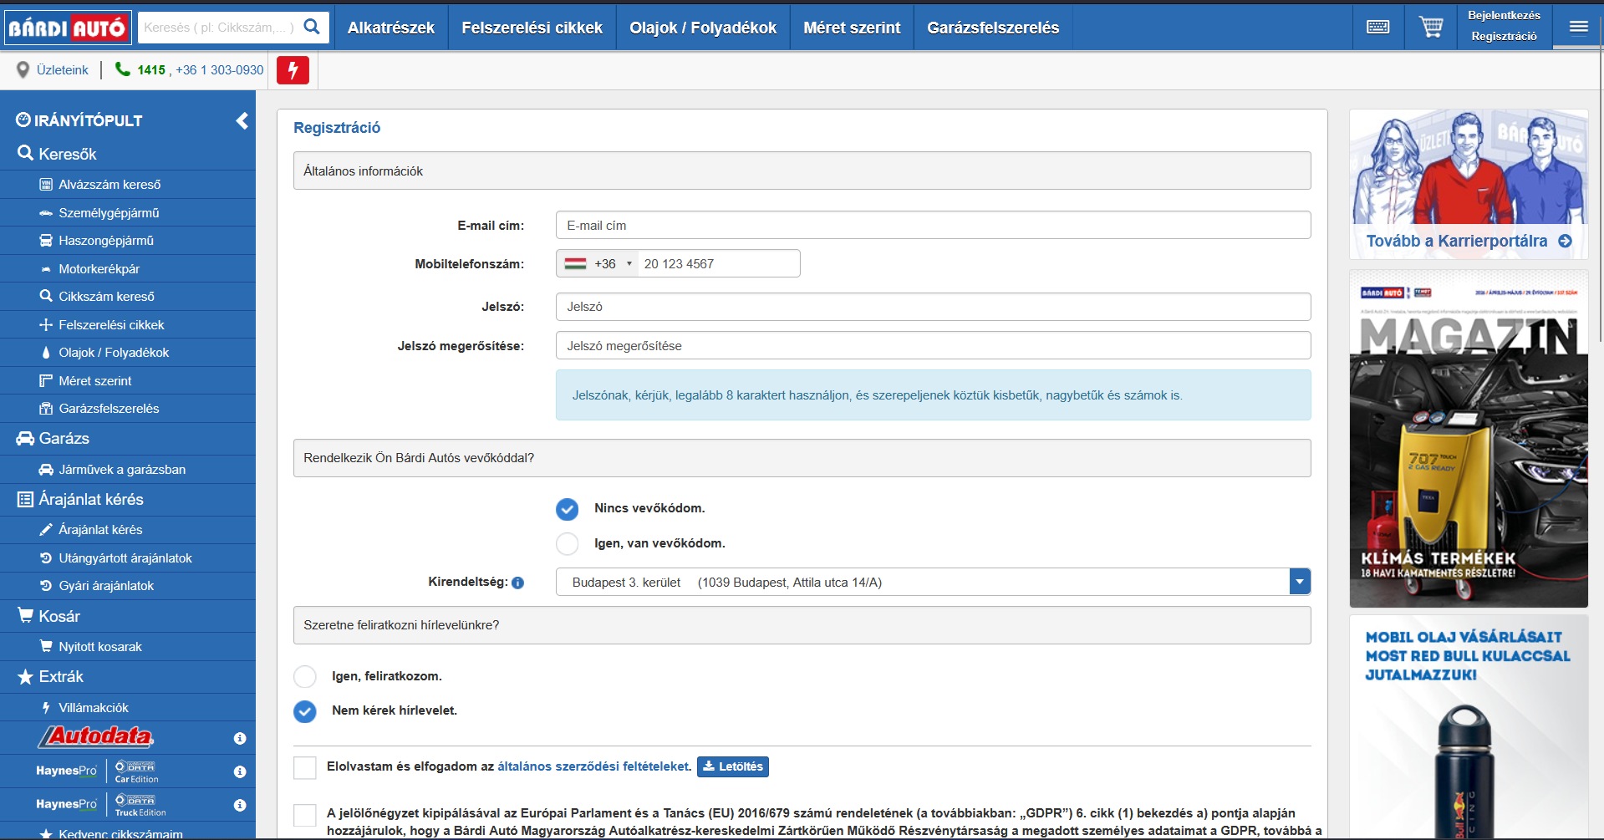
Notes:
... Let us introduce carcomps! made by Nebl Gergő (Database) , Kis-Borbás Dorián Zsolt (Backend), Mészáros Roland (PM, Frontend).

Slide 4

WHAT IS CARCOMPS?
Notes:
CarComps is an online marketplace where you can buy various vehicle parts for cars, motorcycles and trucks.

Slide 5
WHY CARCOMPS?
Notes:
WHY would you choose carcomps, because We deliver our website with modern and unique webdesign (like user profile payment page) with secure servers, modern infrastructures and scaleable database. These lead to a User Friendly experience. The team is very excited and well prepared, hope you Will enjoy our presentation about CarComps.

Slide 6
HOW WE BUILT CARCOMPS?
Notes:
We built carcomps with webbapp architecture. So we used the following developer areas.

Slide 7
DATABASE
Notes:
Database - What was my part in the project?
My primary responsibility was designing and implementing the entire database architecture for our webshop. I focused on creating a robust, scalable, and production-ready database that handles complex business logic while ensuring data integrity and security.

Slide 8


DATABASE
Design & Implement table structure
Notes:
At first i used an older version of MYSQL then later i upgraded to a more modern version because it's more reliable and widely supported. I implemented business logic through stored procedures rather than putting everything in the backend code. Stored Procedures: I built all CRUD operations and complex business logic as stored procedures. It was challenging to master transaction management and concurrency control, this makes operations like order processing much safer with either everything succeeds or nothing does.
Concurrency Control: I implemented FOR UPDATE row-level locking to prevent overselling. This was important(crucial), without it, two customers could buy the same last item at the same time. The database now locks rows during stock checks to ensure only one transaction succeeds with the help of FOR UPDATE

Slide 9
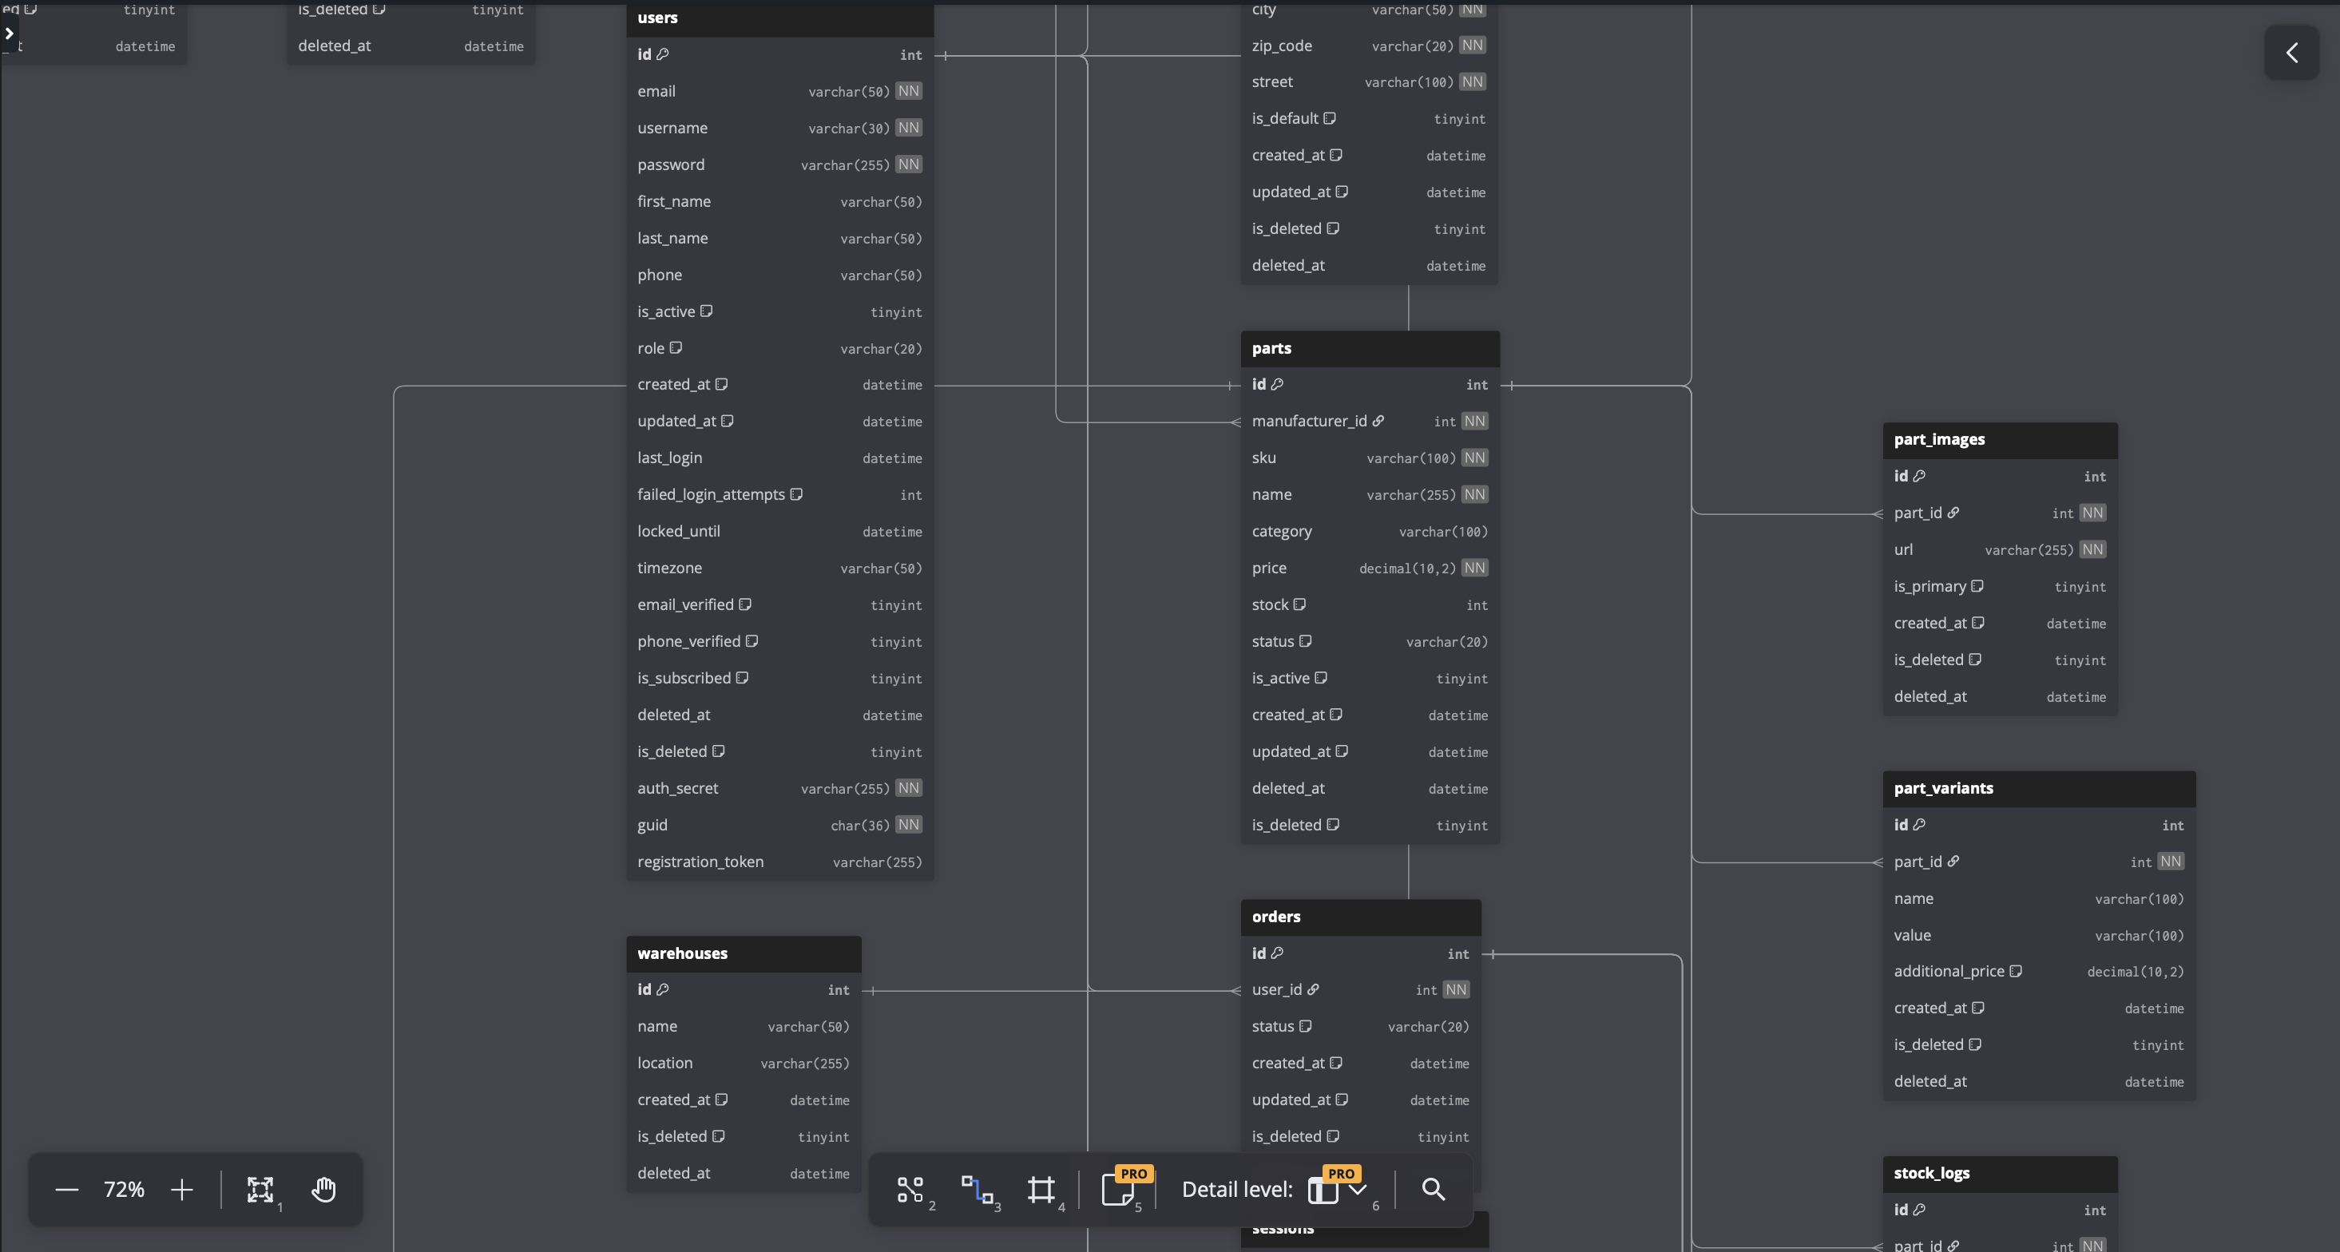
Notes:
DB DIAGRAM: When we planned the database, i used DB Diagram to visualise our database structure and the tables connections with eachother, i decided to use DB Diagram because it's (simple to use and the visual diagram made it easier for me to understand the database and how to build out our database). In the end we created x tables with y procedures.

Slide 10
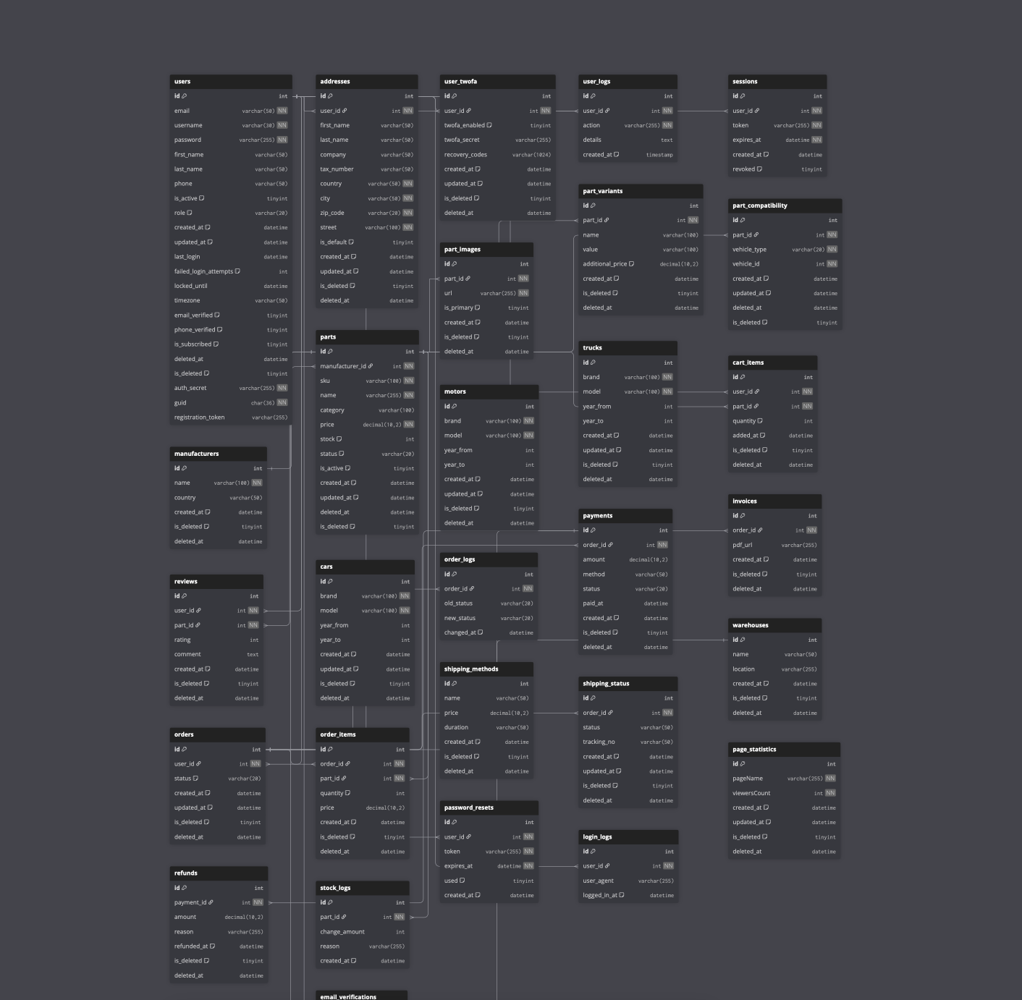
Notes:
DB DIAGRAM: When we planned the database, i used DB Diagram to visualise our database structure and the tables connections with eachother, i decided to use DB Diagram because it's (simple to use and the visual diagram made it easier for me to understand the database and how to build out our database). In the end we created x tables with y procedures.

Slide 11
BACKEND
DATABASE
Notes:
backend: i was responsible for the funcionality of the website.

Slide 12



BACKEND
Server Handling & Deployment
RESTful APIs
Notes:
I made the backend code in java with help from Gergő. Together we wrote over 30k lines of code. We used java because we wanted to learn a new language besides c# and python.
:D
I also handled the server and deployment setup using Cloudflare, i used Cloudflare because its free and easy to use.
I was also tasked with configuring the Cloudflare Tunnel, which securely connected the website to my laptop, as well as setting up and managing the custom domain.
Beyond the backend and infrastructure, I contributed to several supporting areas:
I created the project logo
Assisted with UI and design decisions
Populated the database with content and test data
Helped with general troubleshooting and planning
Overall, my job was making sure the website was functional, secure, and deployable, while also supporting the visual and data side of the project.

Slide 13
FRONTEND
DATABASE
BACKEND
Notes:
frontend:
My primary responsibility was transforming our concept into a fully functional, visually compelling web application. I focused on creating a modern, clean, and unique user interface that delivers an exceptional user experience.

Slide 14


FRONTEND
Angular Framework & Features
Figma
Notes:
For the design I used Figma because Its easy to design and create a prototype of your webpage.
I used Angular Framework to code the webpage. It was hard to learn and I'm still learning it but it makes coding easier by its component driven feature. Also its scalable and long term maintainable.
I used signals for reactive state integrated Rest API's
and routes because of the guards feature
Design System: Consistent color palette (#ff6600 orange primary, #2b2b2b dark charcoal like, #fffafa light snow white)
orange is associated with energy and performance colors, charcoal dark and snow white feels like trust and clarity and good mobilization on the webpage
I recreated the palletes 3 times :DDDDDDDDDDDD

Slide 15


DATABASE
BACKEND
FRONTEND
Notes:
Now that we talked about our responsibilities, let me talk about other technologies we used

Slide 16







OTHER TECHNOLOGIES

Slide 17
TESTING CARCOMPS
Notes:
How we tested CarComps?

Slide 18
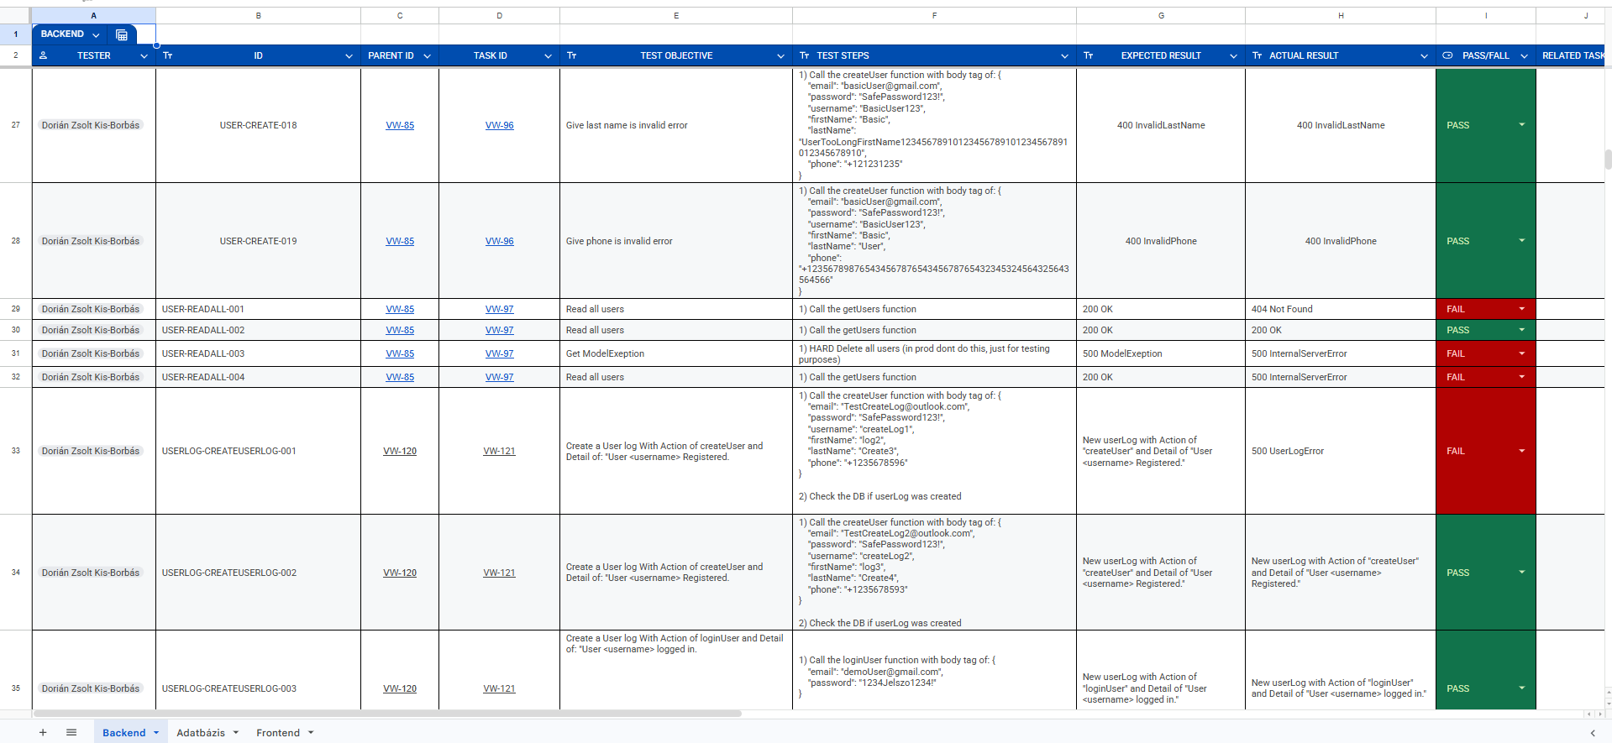

Slide 19
WORKFLOW IN CARCOMPS
Notes:
How we splitted up our work

Slide 20
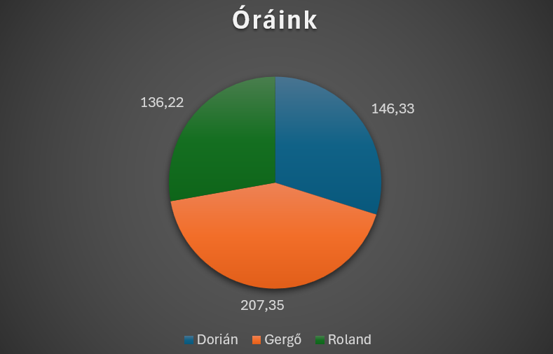

Slide 21
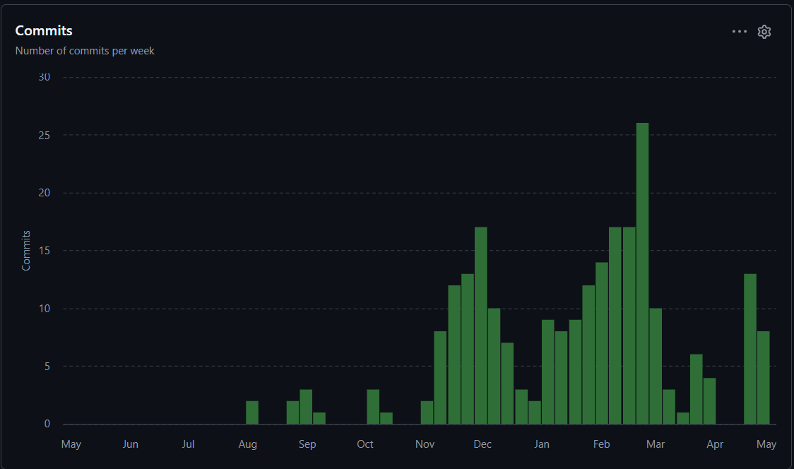

Slide 22
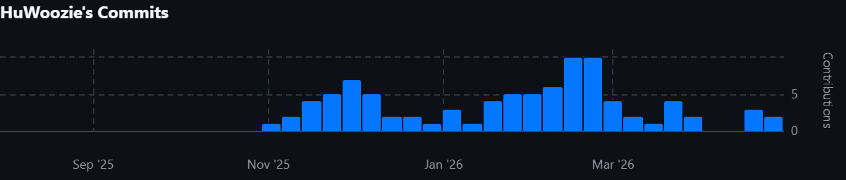
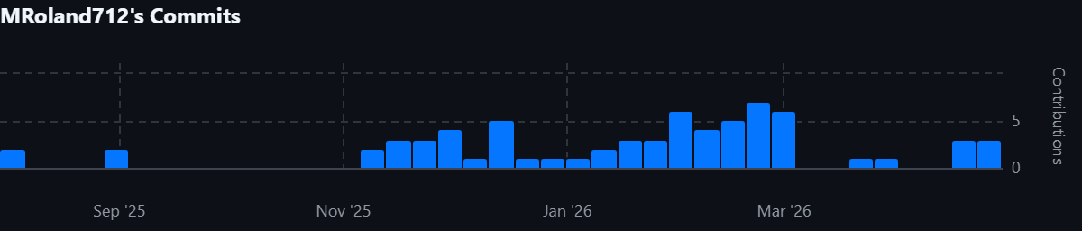
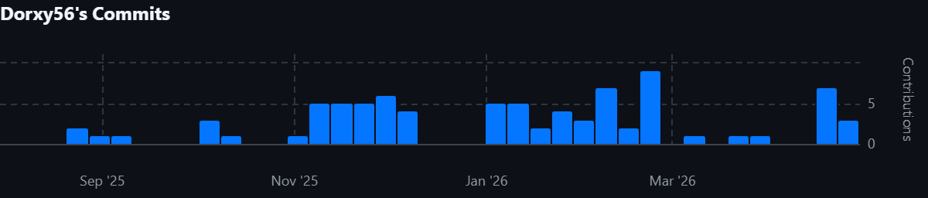

Slide 23
FUTURE PLANS FOR CARCOMPS
Notes:
future plank

Slide 24
24/7 server
More statistics
Better review system
Full Logistics dashboard
Card payment implementation
Notes:
We want to maintain a 24/7 server. We want to expand our statistics
We want to implement a better review system (such as hiring staffs to reply to the reviews and letting users attach pictures to their reviews)

Slide 25
TRY CARCOMPS!
Notes:
Lets try our website!

